Slide 1
Implementing Mass storage

Slide 2
Partitioning/Formatting
Chapter › Topic
After you’ve successfully installed a hard drive, you must perform 2 more steps to translate a drive’s raw media into something that the system can use.
.
Partitioning
the process of electronically subdividing a physical drive into one or more units called partitions. After
partitioning, you must format the drive.
Formatting
installs a file system onto the drive that organizes each partition in such a way that the operating system can store files and folders on the drive
Source: …

Slide 3
Agenda
Hard Drive Partitions
Partitioning schemes: MBR, GPT and Dynamic Disks
Hard Drive Formatting
The Partitioning, Formatting and Pooling process

Slide 4
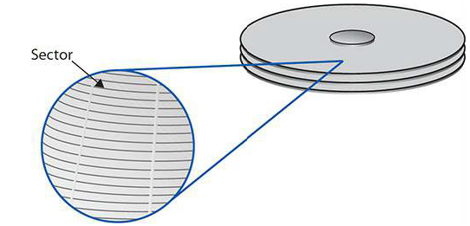
Hard Drive partitions
Before a magnetic disk drive leaves the factory, it is magnetically preset with
millions (hundreds of millions on really big drives) of storage areas known as
sectors. Older hard drives had 512-byte sectors; modern drives use 4096-byte Advanced Format (AF) sectors.
A sector is a physical spot on a formatted disk that holds information. When a disk is formatted, tracks are defined (concentric rings from inside to the outside of the disk platter. Each track is divided into a slice, which is a sector.
Solid-state drives come from the factory with each NAND chip storing
millions (hundreds of millions on really big drives) of 4096-byte (4KB) storage areas known as pages.
Sector (HDD) vs. Page (SDD)

Slide 5
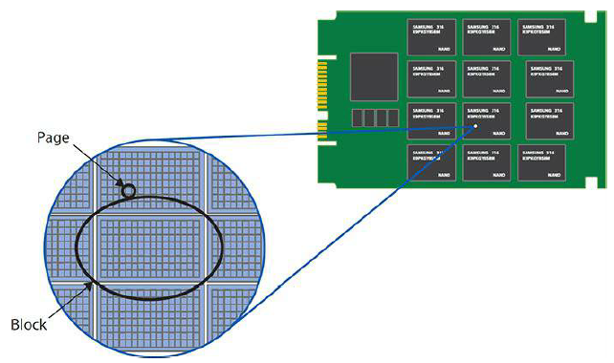
Hard Drive Partitions
A group of pages or sectors are combined into a block that the OS can address (point to). The size of a block varies. A block might be one sector (page), or it might be several sectors (pages). The bigger the drive, the more sectors that a block will hold.
So why are there blocks. Why doesn't the operating system just point straight to the sectors? Because there are limits to the number of blocks, or drive addresses, that an operating system can address. By defining a block as several sectors, an OS can work with bigger hard drives without increasing the number of block addresses.
Blocks
When files are stored on a disk, they always use up a whole number of blocks. Any unneeded space at the end of a block is unused and wasted.
Notes:
With current versions of the OS's, the formatting software will look at the size of the drive, and figure out the smallest number of sectors that need to be in a block in order to be able to use the entire drive.

Slide 6
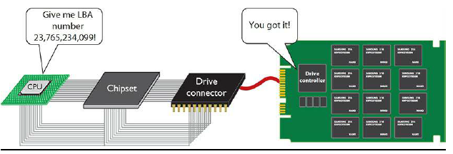
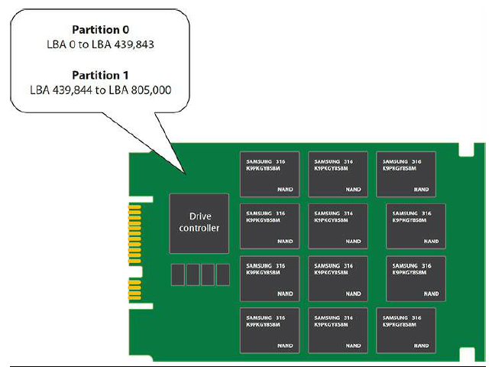
Hard Drive Partitions
The controller on the HDD or SSD uses logical block addressing (LBA) to present all these storage chunks as nothing more than a number that starts at LBA0 and goes until every sector or page has an LBA number. These LBA chunks are also called blocks.
LBA makes addressing any form of mass storage easy, and that’s how the operating system interacts with the mass storage, via blocks
CPU works with hard drive
The operating system presents to the user files and folders, not LBA addresses. We must organize mass storage in a way that enables us to store and retrieve files, create folders, etc. The first step to doing this is partitioning.
If you think of a hard drive as an empty building filled with many rooms (the blocks), partitioning is what organizes the rooms into something bigger (like suites or companies) and gives each bigger entity a name.
Partitioning takes a single physical drive and electronically organizes it into one or more . . . partitions. With that analogy, think of partitions as collections of rooms in the building. Partitions provide tremendous flexibility in hard drive organization. With partitions, you can organize a drive to suit your personal taste.

Slide 7
Agenda
Hard Drive Partitions
Partitioning schemes: MBR, GPT and Dynamic Disks
Hard Drive Formatting
The Partitioning, Formatting and Pooling process

Slide 8
Partitioning Scheme
The first sector of an MBR hard drive contains the master boot record (MBR) code that informs the system about installed operating systems. To clarify, hard drives that use the MBR partitioning scheme have a tiny bit of data that is also called the “master boot record.”
While your computer boots up, BIOS looks at the first sector of your hard drive for instructions. At this point, it doesn’t matter which OS you use or how many partitions you have. Without this bit of code, your OS will never load.
The master boot record also contains the partition table, which describes
the number and size of partitions on the disk.
MBR partition tables support two types of partitions: primary partitions and extended partitions. Primary partitions are designed to support bootable operating systems. Extended partitions are not bootable. A single MBR disk may have up to four primary partitions or up to three primary partitions and one extended partition.
MBR hard drive can have up to 2TB.
Master Boot Record
A partition table format (or partition style) refers to the method that an operating system uses to organize partitions or volumes on a disk.

Slide 9
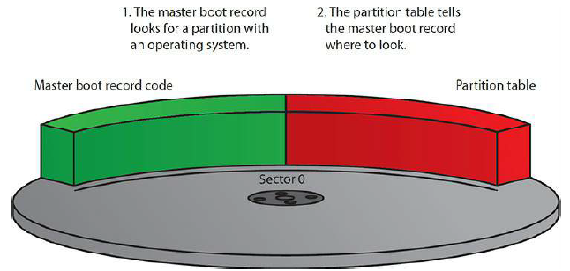
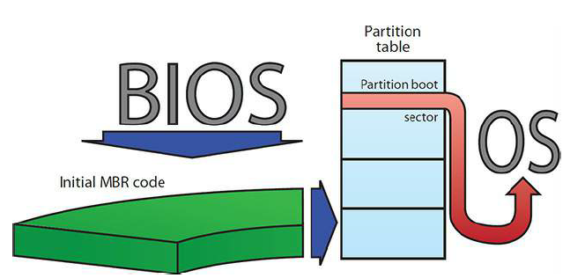
Partitioning Scheme
MBR partition tables support up to four partitions—the partition table is large enough to store entries for only four partitions. The instructions in the master boot record use this table to determine which partition contains the active operating system.
After the MBR locates the appropriate partition, the partition boot sector
loads the OS on that partition. The partition boot sector stores information
important to its partition, such as the location of the OS boot files
Master Boot Record

Slide 10
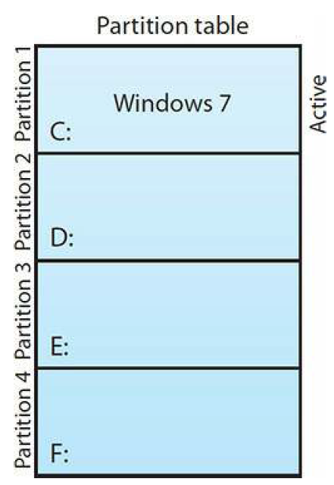
Partitioning Scheme
Only primary partitions can boot operating systems. On an MBR disk, you can easily install four different operating systems, each on its own primary partition, and boot to your choice each time you fire up the computer.
Every primary partition on a single drive has a special setting stored in the partition table called active that determines the active partition. During bootup,
the BIOS/POST reads the MBR to find the active partition and boots the operating system on that partition. Only one partition can be active at a time because you can run only one OS at a time.
Primary Partitions & Multiple Operating Systems

Slide 11
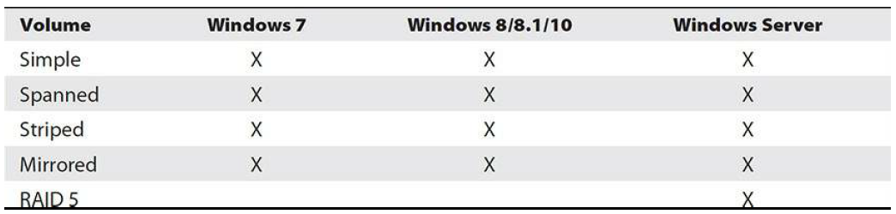
Partitioning Scheme
Dynamic disks are used for configuring fault tolerance storage.
Microsoft calls a drive structure created with a dynamic disk a volume
A dynamic disk volume is still technically a partition, but it can do things a regular partition cannot do:
You’re not limited to four partitions.
Second, you can create—in software—new drive structures that you can’t do with MBR drives. Specifically, you can implement RAID, span volumes over multiple drives, and extend volumes on one or more drives
Dynamic Disks

Slide 12
Partitioning Scheme
The GUID partition table (GPT) partitioning scheme shares a lot with the MBR partitioning scheme, but most of the MBR scheme’s limitations have been fixed. Here are the big improvements:
• While MBR drives are limited to four partitions, a GPT drive can have
an almost unlimited number of primary partitions. Microsoft has
limited Windows to 128 partitions.
• MBR partitions can be no larger than 2.2 TB, but GPT partitions have
no such restrictions. Well, there is a maximum size limit, but it’s so
large, we measure it in zettabytes. A zettabyte, by the way, is roughly a
billion terabytes.
On paper, a GPT drive looks a lot like an MBR drive, except it’s arranged
by LBA instead of sectors (see Figure 9-10). LBA 0, for instance, is the
protective MBR. This is a re-creation of the master boot record from MBR
drives so that disk utilities know it is a GPT drive and don’t mistakenly
overwrite any partition data.
GUID Partition table

Slide 13
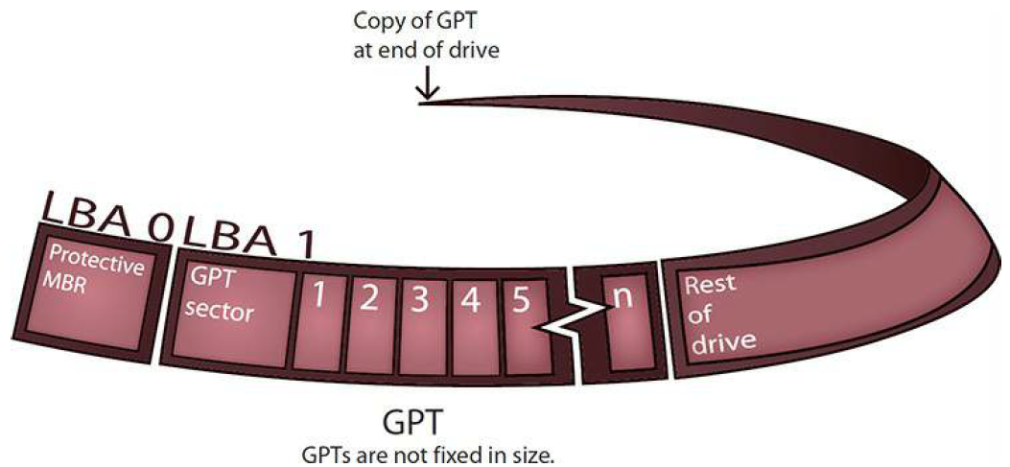
Partitioning Scheme
Instead of the old master boot record and partition table, GPT drives use a GPT header and partition entry array. Both are located at the beginning and end of the drive so there is a protected backup copy. The partitions on a GPT drive go between the primary and backup headers and arrays.
GUID Partition Table

Slide 14
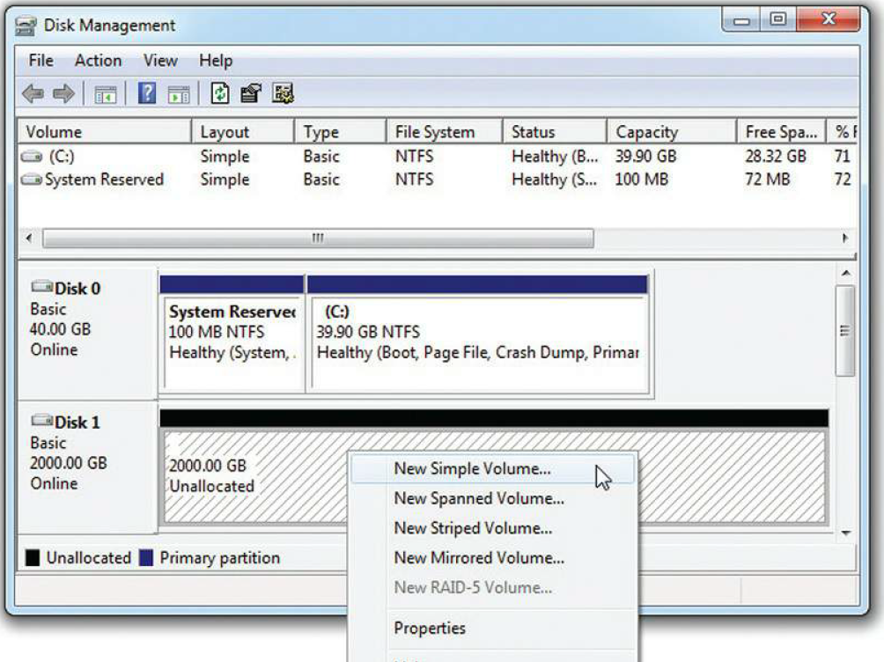
Partitioning Scheme
When you install an OS on a new system, and
When you add an additional drive to an existing system
you’ve learned that MBR and GPT disks use partitions and dynamic
disks use volumes. Unfortunately, when you create a new partition or volume
in current versions of Windows (8, 8.1, 10), the tool (Disk Management) only
shows that you’re about to create a volume.
Even though the context menu says “volumes,” you create partitions on
basic disks
When to partition

Slide 15
Partitioning Scheme
 | MBR | GPT
Max. number of partitions | 4 primary partitions per drive | 128 partitions per drive
Disk’s maximum size | 2 TB (2.19 x 10^12 bytes) If you initialize a disk larger than 2 TB using MBR, the disks stores volumes only up to 2 TB, and the rest of the storage is not used. You must convert the disk to GPT if you want to use all of its space. | 18 exabytes per partition 8 zettabytes (ZB) per disk, with 512KB logical block addressing (LBA).
MBR vs. GPT

Slide 16
Agenda
Hard Drive Partitions
Partitioning schemes: MBR, GPT and Dynamic Disks
Hard Drive Formatting
The Partitioning, Formatting and Pooling process

Slide 17
Hard Drive Formatting
Formatting, the process of making a partition into something that stores
files, does two things.
First, it creates a file system—an organization of all the blocks contained in that partition, enabling file storage and retrieval.
Second, formatting creates a root directory in the file system to enable the partition to store folders. You must format every partition/volume so they can hold and retrieve data.
Every operating system has its own file systems.
macOS uses a couple of file systems called APFS and HFS+.
Linux users have lots to choose from; most use ext4 but you will see others with names like BTRFS, XFS, ZFS, etc.
Windows has file systems with names like NTFS, FAT32, and exFAT.

Slide 18
Hard Drive Formatting
All Windows file systems organize blocks of data into groups called clusters. The size of each cluster varies according to the file system and the size of the partition. Windows uses clusters to overcome some of the limitations in addressing inherent to each file system.
File system in Windows

Slide 19
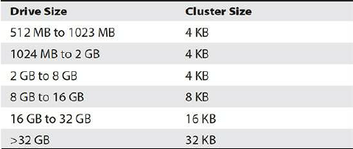
Hard Drive Formatting
FAT32
The base storage area for hard drives is a block; each block stores up to 4096 bytes of data. In a small partition, each cluster is made up of one block. If a file is larger than 4096 bytes, it will use as many clusters as needed to store the file.
The OS needs a method to fill one cluster, find another that’s unused, and fill it, continuing to fill clusters until the file is completely stored. Once the OS stores a file, it must remember which cluster holds the file, so it can be retrieved later. If an OS stores a file smaller than 4096 bytes, the rest of the cluster goes to waste.
File system in Windows

Slide 20
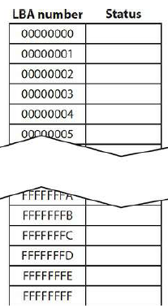
Hard Drive Formatting
FAT32
MS-DOS version 2.1 first supported hard drives using a data structure and indexing system to keep track of stored data on the hard drive, and Microsoft called this structure the file allocation table (FAT). Think of the FAT as nothing more than a card catalog that keeps track of which clusters store the various parts of a file.
The left column gives each cluster a hexadecimal number from 00000000 to FFFFFFFF. Each hexadecimal character represents four binary numbers or 4 bits. Eight hex characters, therefore, represent 32 bits. You’ll find that there are over four billion clusters that can be tracked or indexed.
We call this type of FAT a 32-bit FAT or FAT32. And it’s not just hard drives and SSDs that have FATs. Many USB flash drives use FAT32.
File system in Windows

Slide 21
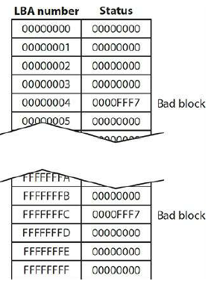
Hard Drive Formatting
FAT32
The right column of the FAT contains information on the status of clusters. All hard drives, even brand-new drives fresh from the factory, contain faulty blocks that cannot store data because of imperfections in the construction of the drives. The OS must locate these bad blocks, mark them
as unusable, and then prevent any files from being written to them. This mapping of bad blocks is one of the functions of high-level formatting. After the format program creates the FAT, it marches through every block of the entire partition, writing and attempting to read from each block sequentially.
If it finds a bad block, it places a special status code (0000FFF7) in the block’s FAT location, indicating that the cluster is unavailable for use.
Good blocks: code 00000000.
High level formatting (quick format) >< full format (scan all sectors)
File system in Windows

Slide 22
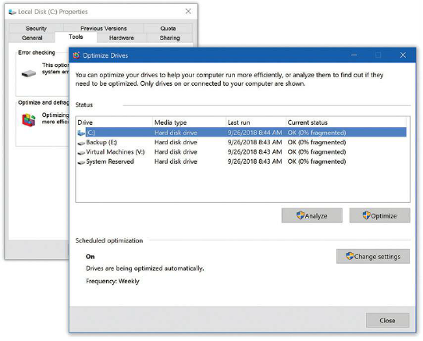
Hard Drive Formatting
FAT32
Defragmentation
In the real world, a file might fragment into hundreds of pieces, forcing the read/write heads to travel all over the hard drive to retrieve a single file. You can dramatically improve the speed at which the hard drive reads and writes files by eliminating this
fragmentation.
Windows comes with a program called Disk Defragmenter (Windows 7) or Optimize Drives (Windows 8/8.1/10) that can rearrange the files into neat contiguous chunks. Windows does this automatically by default.
Modern SSDs have a feature called trim that enables the OS to issue
commands to clean up and reuse deleted areas. This happens automatically, so there’s no reason at all to defragment any SSD.
File system in Windows

Slide 23
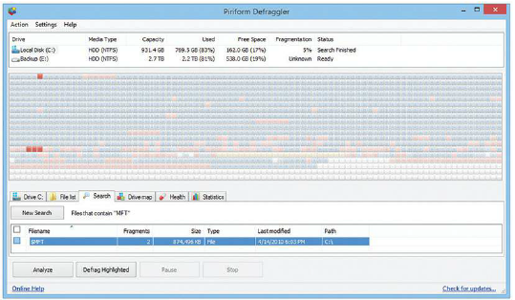
Hard Drive Formatting
NTFS (New Technology File System)
NTFS uses clusters of blocks and file allocation tables, but in a much more complex and powerful way compared to FAT32. NTFS offers six major improvements and refinements: redundancy, security, compression, encryption, disk quotas, and cluster sizing.
NTFS Structure
NTFS utilizes an enhanced file allocation table called the master file table (MFT). An NTFS partition keeps a backup copy of the most critical parts of the MFT in the middle of the disk, reducing the chance that a serious drive error can wipe out both the MFT and the MFT copy. Whenever you defragment an NTFS partition, you’ll see a small, immovable chunk somewhere on the drive, often near the front; that’s the MFT.
File system in Windows

Slide 24
Hard Drive Formatting
NTFS (New Technology File System)
Security
NTFS views individual files and folders as objects and provides security for
those objects through a feature called the Access Control List (ACL). Future
chapters go into this in much more detail.
Compression
NTFS enables you to compress individual files and folders to save space on a hard drive. Compression makes access time to the data slower because the OS must uncompress files every time you use them, but in a space-limited environment, sometimes that’s what you have to do. Windows Explorer/File Explorer displays filenames for compressed files in blue.
Encryption
One of the big draws with NTFS is file encryption, the black art of making
files unreadable to anybody who doesn’t have the right key. You can encrypt
a single file, a folder, or a folder full of files. Microsoft calls the encryption
utility in NTFS the encrypting file system (EFS)
File system in Windows

Slide 25
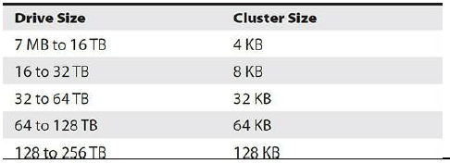
Hard Drive Formatting
NTFS (New Technology File System)
Disk Quotas
NTFS supports disk quotas, enabling administrators to set limits on drive
space usage for users. To set quotas, you must log on as an Administrator.
Cluster Sizes
NTFS uses clusters, much like FAT32. The numbers equate to block size
until you get to very large partitions.
File system in Windows

Slide 26
Hard Drive Formatting
ReFS
Windows Server 2012 first introduced ReFS to enhance the capabilities of NTFS. ReFS improves upon NTFS by offering larger maximum sizes for individual files, directories, disk volumes, and other items.
Additionally, ReFS offers greater resiliency, meaning better data verification, error correction, and scalability.
However, you cannot use ReFS for the boot volume.
When to use ReFS
• Microsoft Hyper-V workloads. ReFS has performance advantages when using both .vhd and .vhdx
files.
• Storage Spaces Direct. In Windows Server 2016, nodes in a cluster can share direct attached storage.
In this situation, ReFS provides improved throughput, but also supports higher capacity disks used by the cluster nodes.
• Archive data. The resiliency that ReFS provides means it is a good choice for data that you want to retain for longer periods.
File system in Windows

Slide 27
Hard Drive Formatting
ReFS
provides the following advantages over NTFS:
• Metadata integrity with checksums
• Expanded protection against data corruption
• Maximizes reliability, especially during a loss of power (while NTFS has been known to experience corruption in similar circumstances)
• Large volume, file, and directory sizes
• Storage pooling and virtualization, which makes creating and managing file systems easier
• Redundancy for fault tolerance
• Disk scrubbing for protection against latent disk errors
• Resiliency to corruptions with recovery for maximum volume availability
• Shared storage pools across machines for additional failure tolerance and load balancing
ReFS inherits some features from NTFS, including the following:
• BitLocker Drive Encryption
• ACLs for security
• Update sequence number (USN) journal
• Change notifications
• Symbolic links, junction points, mount points and reparse points
• Volume snapshots
• File IDs
File system in Windows

Slide 28
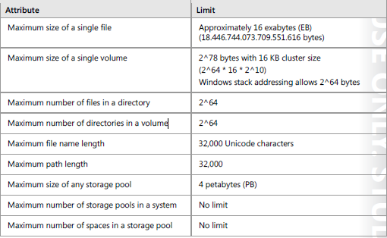
Hard Drive Formatting
ReFS
ReFS uses a subset of NTFS features, so it maintains backward compatibility with NTFS. Therefore, programs that run on Windows Server 2016 can access files on ReFS just as they would on NTFS.
However, an ReFS-formatted drive is not recognized when placed in computers that are running Windows Server OS that were released before Windows Server 2012. You can use ReFS drives with Windows 10 and Windows 8.1, but not with Windows 8.
NTFS enables you to change a volume’s allocation unit size. However, with ReFS, each volume has a fixed size of 64 KB, which you cannot change. ReFS does not support Encrypted File System (EFS) for files
File system in Windows

Slide 29
Hard Drive Formatting
exFAT
People today want to share more than just a few small files, and they can do so with larger flash drives. As flash drives grow bigger in capacity, however, the file system becomes a problem.
The file system we have used for years on flash drives, FAT32, does not
work on drives larger than 2 TB. Worse, FAT32 limits file size to 4 GB.
The newer file system, called exFAT, breaks the 4-GB file-size barrier,
supporting files up to 16 exabytes (EB) and a theoretical partition limit of 64
zettabytes (ZB). Microsoft recommends a partition size of up to 512 TB on
today’s larger USB flash drives, which should be enough for a while. The
exFAT file system extends FAT32 from 32-bit cluster entries to 64-bit cluster
entries in the file table.
Like FAT32, on the other hand, exFAT still lacks all of NTFS’s extra features such as permissions, compression, and encryption.
File system in Windows

Slide 30
Hard Drive Formatting
You can manage virtual hard disks within Windows Server 2016 in much the same way that you can manage physical disks. For example, you can create and attach a virtual hard disk and use it for storing data. The virtual hard disk appears as another drive letter in the disk or folder management tools.
• In Windows 7 and Windows Server 2008 R2, you can only work with .vhd files.
• In Windows 8, Windows 8.1, Windows 10, or Windows Server 2012 or later, you also can create and manage .vhdx files, which enable much larger disk sizes and provide other benefits.
• You can create and attach virtual hard disks by using disk management tools such as Disk Management and Diskpart.exe. After creating and attaching the virtual hard disk, you can create volumes on the drive and format the partition. Additionally, in Windows 8 or newer versions, and Windows Server 2012 or newer versions, you can mount virtual hard disks in File Explorer.
• You can configure Windows Server 2016 to start from a virtual hard disk using the native virtual hard disk boot feature. This feature enables you to configure multiple operating systems on a single computer and choose which operating system to use when you start the computer.
• You can attach virtual hard disks that you create by using Hyper-V, or that you create on another computer. For example, if you create a virtual hard disk in Hyper-V, you can copy that virtual hard disk to another computer, and then use the native virtual hard disk boot feature to start the computer using the virtual disk that you created in Hyper-V.
• You can use virtual hard disks as a deployment technology. For example, you can use Hyper-V to create a standard image for desktop or server computers, and then distribute the image to other computers.
.vhd and .vhdx file types

Slide 31
Hard Drive Formatting
The classic file system for Macs is Hierarchical File System Plus (HFS+). While still required for Time Machine drives, all new Macs (and existing systems upgrading macOS) come with the Apple File System (APFS) by default.
Like Windows and Linux, macOS can read and write to several different file systems such as FAT32 and exFAT, though only read NTFS.
File system in macOS

Slide 32
Hard Drive Formatting
Most Linux distributions use a file system known as the Fourth Extended
File System (ext4) by default. Some older distros use one of its predecessors, such as ext2 or ext3. The ext4 file system supports volumes up to 1 exabyte (EB) with file sizes up to 16 TB and is backwardly compatible with ext2 and ext3.
Many Linux distributions, especially at the enterprise level (big data
centers), use ZFS file system or its newer cousin, BTRFS (pronounced,
“butter eff ess”).
Linux file system capabilities exceed those of both macOS and
Windows, being able to read and write to NTFS, FAT32, exFAT, HFS+, and
ext4.
File system in Linux

Slide 33
Hard Drive Formatting
 | FAT32 | exFAT | NTFS | ReFS
Max. drive size | 32GB (set by Microsoft – theoretically 16TB = 4KB x 2^32) | Theoretically 64 EB – recommended 512TB | 8 petabytes
Max. file size | 4GB | 16EB
Max cluster size | 4KB | 32MB |  | 64KB

Slide 34
Agenda
Hard Drive Partitions
Partitioning schemes: MBR, GPT and Dynamic Disks
Hard Drive Formatting
The Partitioning, Formatting and Pooling process

Slide 35
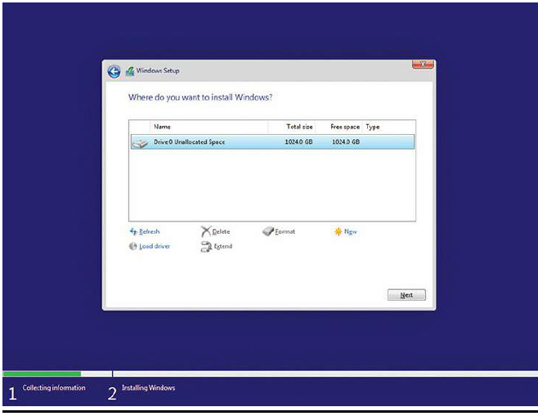
The Partitioning, Formatting, and Pooling Process
Any removable media that has a bootable OS is generically called a boot device or boot disc. Your system boots off of the boot device, which then loads some kind of OS that enables you to partition, format, and install an OS on your new hard drive.
Boot devices may also be a medium that has an image of an installation
disc. These images are usually stored as a file with a name that has an
extension of “.iso.” Image files may be on a traditional boot device, such as a
disc or flash drive, but they can come from anyplace, such as on a network
drive.
Every boot device has partitioning tools and a way to format a new
partition. A hard drive must have a partition and has to be formatted to
support an OS installation.
Boot Media

Slide 36
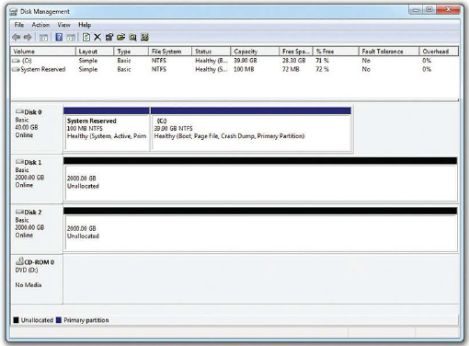
The Partitioning, Formatting, and Pooling Process
The Disk Management utility is the primary graphical tool for partitioning and formatting drives after installation:
• Initialize disks
• Create and modify volumes
Disk Management

Slide 37
The Partitioning, Formatting, and Pooling Process
The Disk Management utility is the command prompt tool for partitioning and formatting drives after installation:
• Initialize disks
• Create and modify volumes
Diskpart.exe

Slide 38
The Partitioning, Formatting, and Pooling Process
• Check a disk for an NTFSformatted volume
• Cannot be used for ReFS or virtual disks
Chkdsk.exe

Slide 39
The Partitioning, Formatting, and Pooling Process
• Disk defragmentation tool for NTFS-formatted volumes.
• Cannot be used for ReFS or virtual disks
Defrag.exe

Slide 40
The Partitioning, Formatting, and Pooling Process
You also can use Windows PowerShell cmdlets to manage disk partitions and volumes. The following list
explains some of the more common disk management cmdlets:
• Get-disk. Lists all available disks installed in the server computer.
• Clear-disk. Removes all partitions and volumes from the specified disk.
• Initialize-disk. Enables you to initialize a disk in readiness for creation of volumes.
• Get-volume. Lists all accessible volumes.
• Format-volume. Enables you to format a volume with NTFS.
Windows PowerShell

Slide 41
The Partitioning, Formatting, and Pooling Process
fsultil

Slide 42
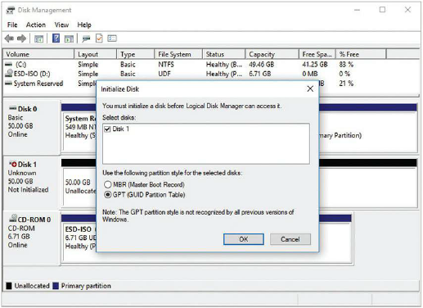
The Partitioning, Formatting, and Pooling Process
All new drives must be initialized before you can use them.
Every hard drive in a Windows system has special information placed onto the drive through a process called disk initialization. This initialization information includes identifiers that say, “this drive belongs in this system” and other information that defines what this hard drive does in the system. If the hard drive is part of a software RAID array, for example, its RAID information is stored in the initialization. If it’s part of a spanned volume, this is also stored there.
Disk Initialization

Slide 43
The Partitioning, Formatting, and Pooling Process
Creating partitions and volumes

Slide 44
The Partitioning, Formatting, and Pooling Process
You create dynamic disks from basic disks in Disk Management. Once you convert a drive from a basic disk to a dynamic disk, primary and extended partitions no longer exist; dynamic disks are divided into volumes instead of partitions.
Once you’ve converted the disk, you can make one of the five types of
volumes on a dynamic disk: simple, spanned, striped, mirrored, or RAID 5
Dynamic Disks

Slide 45
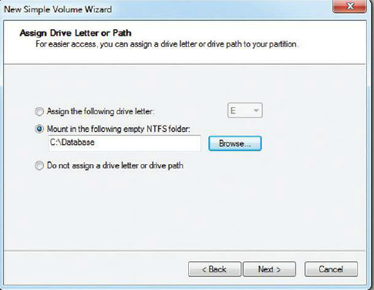
The Partitioning, Formatting, and Pooling Process
While partitions and volumes can be assigned a drive letter, D: through Z:,
they can also be mounted as a folder on another drive, also known as a mount
point. This enables you to use your existing folders to store more data than
can fit on a single drive or partition/volume.
To create a mount point, right-click on an unallocated section of a drive
and choose New Simple Volume. This opens the appropriately named
wizard. In the second screen, you can select a mount point rather than a drive letter (see Figure 9-49). Browse to a blank folder on an NTFS-formatted drive or create a new folder and you’re in business.
Mounting Partitions as Folders

Slide 46
The Partitioning, Formatting, and Pooling Process
You can format any Windows partition/volume in Windows Explorer/File Explorer. Just right-click on the drive name and choose Format.
The Quick Format option tells Windows not to test the blocks and is a handy option when you’re in a hurry.
Formatting a Partition

Slide 47
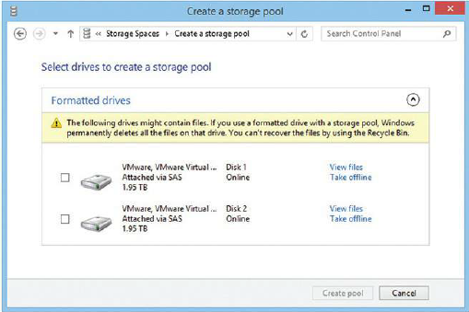
The Partitioning, Formatting, and Pooling Process
With Windows 8 and later versions of the OS, you can group one or more physical drives of any size into a single storage pool. These drives can be internal HDD or SSD or external storage connected via USB.
A storage pool is a collection of physical drives that enables you to flexibly add and expand capacity. Storage spaces are virtual drives that are created from storage pool free space. Storage spaces have resiliency and fixed provisioning.
The thin provisioning feature means you can create a space with more capacity than your current physical drives provide. You might have a storage pool composed of two 2-TB drives and one 3-TB drive, laid out as a two-way mirror. Rather than limit your new space to a 3-TB capacity, you can assign whatever capacity you want, such as 12 TB, because you know your movie collection will grow. When you start to reach the capacity of the physical drives in the pool, Storage Spaces will tell you and enable you to add more physical capacity at that time. Thin provisioning means you don’t have to redo an array or space when you reach the limits of current hardware.
Storage Spaces

